Slide 1
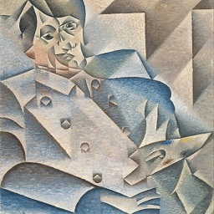
Gradient-based 3D mesh style transfer using 2D supervision
Abhishek Lalwani, Himanshu Gupta, and Rushikesh Dudhat
University of Massachusetts Amherst

